Slide 1




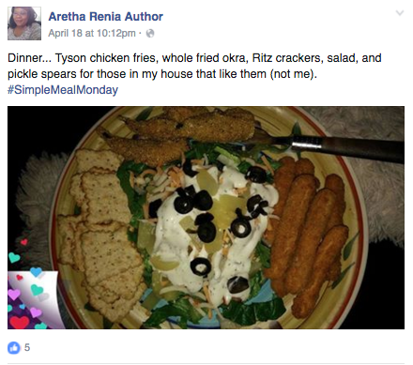
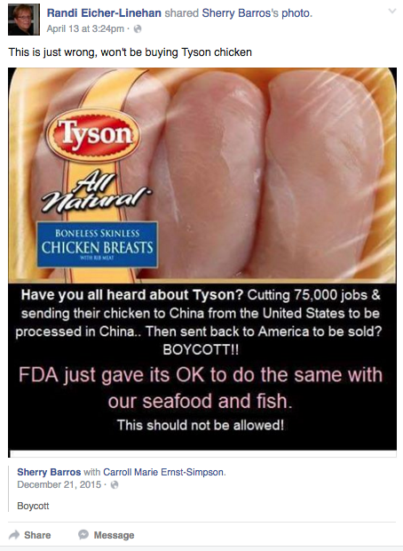
Sanderson Farms Insights for BBDO
Powered by Facebook Topic Data
Run Dates: 4/6/2016 – 4/25/2016
Animal Welfare & Food Safety Insights Summary
PURPOSE: Insightpool aggregated every Facebook interaction relative to Sanderson Farms and its competitors from 4/6/16-4/25/16. Insightpool was able to record 117,400 interactions. The purpose of this analysis was to determine the topics and brands that motivate Facebook influencers to talk about the industry and establish a baseline for those topics for further analysis to identify emerging trends in the conversation over time. Refer to Page #4 for exact list of keywords used to aggregate the ‘Industry’ conversation.
(1) Media Creating Knee-Jerk Reaction from Female Millennials: Both at a local and national level, media outlets like The New York Times and Fox are driving negative conversation around chicken manufacturing. While an insignificant number of consumers are starting these conversations themselves, a particular segment of consumers are more prevalent in engagements with these posts from the media; females over-index by a difference of 20% and Millennials over-index by a difference of 15%.
Recommendation: Continue to identify and monitor the audience that is receptive to the negative conversation and anticipate this audience to lead the negative conversation from a consumer’s perspective if that conversation from consumers increases over time.
(2) Tyson Claiming Bulk of Conversation: Tyson Foods has continued growing its share of the conversation throughout timeline of the analysis. While it has a solid presence in the dinner/recipe conversation, its presence in the negative conversation is more note-worthy. Tyson over-indexed relative to negative sentiment by a difference of 7%. Its decision to relocate much of its processing to China in addition to celebrities like Alec Baldwin speaking out against Tyson for its treatment of chickens were the two main contributors to the over-index of negative sentiment.
Recommendation: The convergence of these two separate occurrences has increased the consumer’s spotlight on the industry. This negative association with the industry leader is likely to spill over onto the other brands in the industry unless action specific to these issues is taken.
(3) Throughout the entire recording, only 100 stories were posted relative to antibiotic use in chickens while the ‘Animal Welfare’ conversation had a great impact on the tone of the overarching industry conversation.
Recommendation: Sanderson can differentiate itself by building more messaging around one of its existing core values: Animal Welfare. While the Antibiotics conversation is important to monitor from a growth or decline aspect, Animal Welfare is the issue that is emerging in the industry.
Conversation Visualization
Tyson vs. Baldwin- Sample Post
Dinner- Sample Post
China (Tyson)- Sample Post

Slide 2
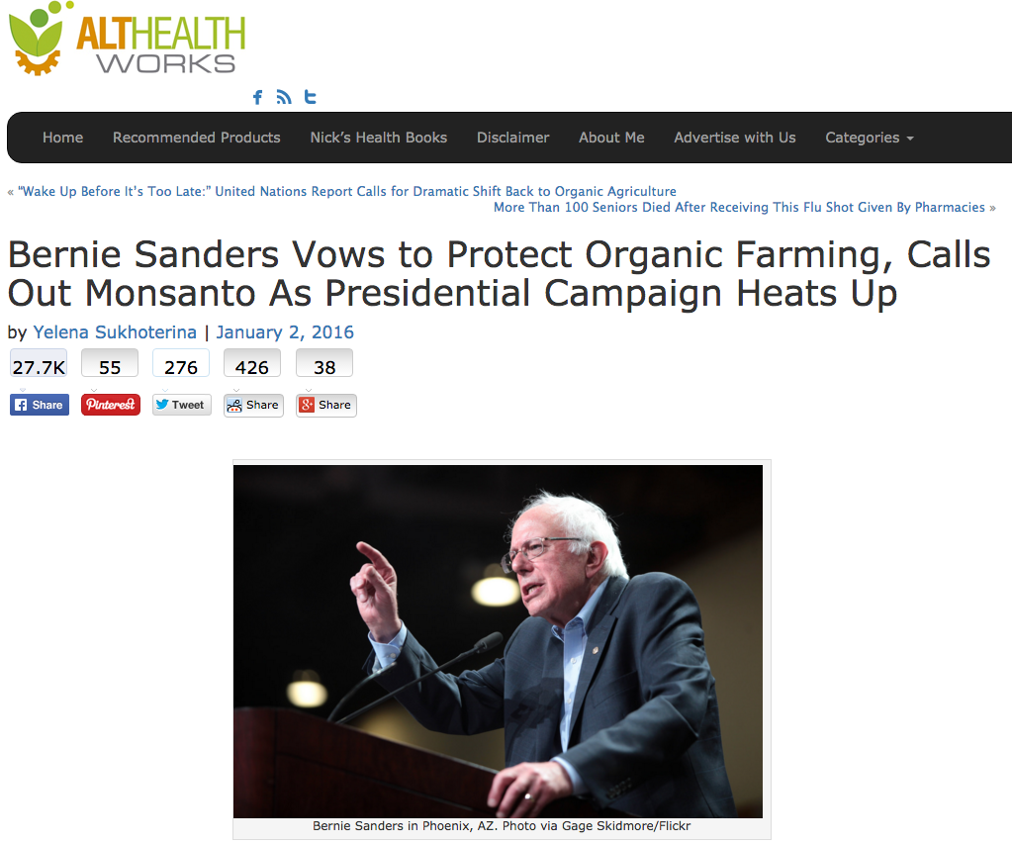
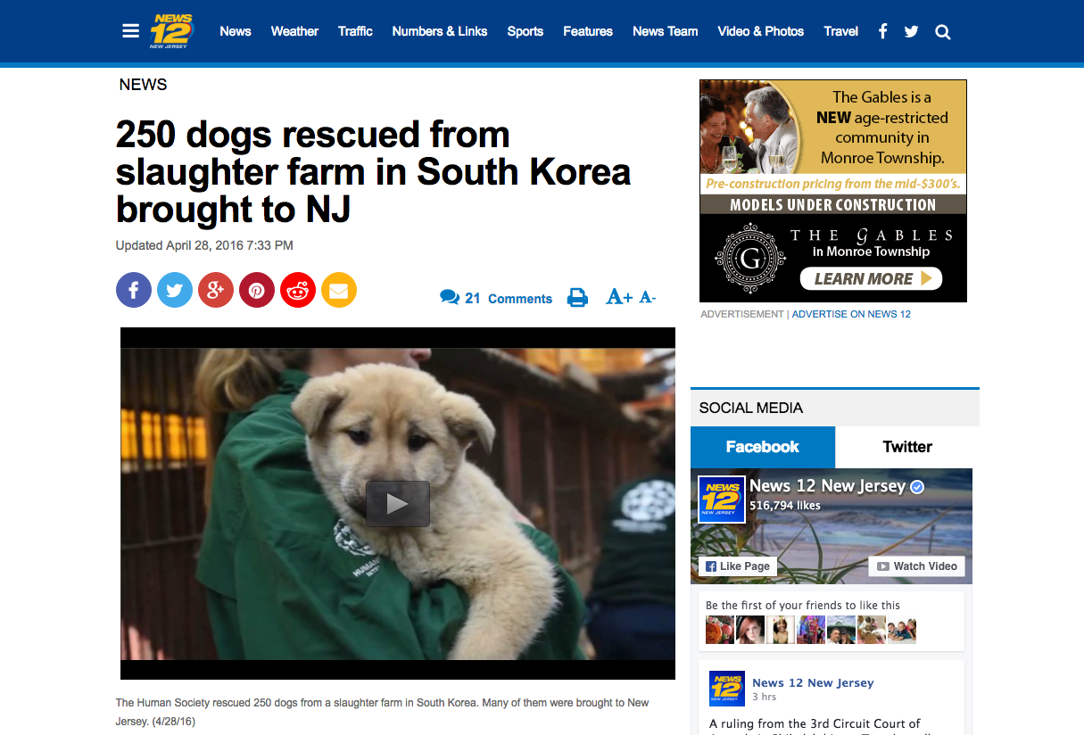
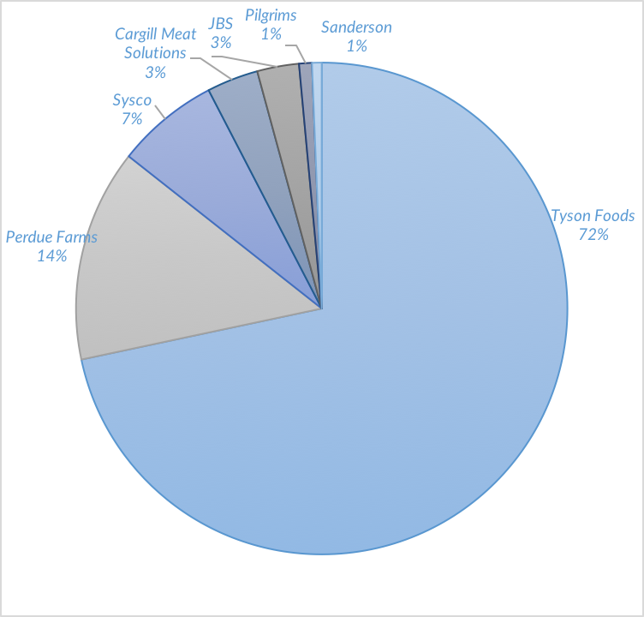
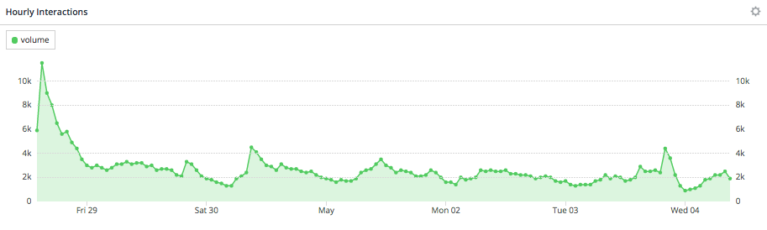
Sanderson Farms Insights for BBDO
Powered by Facebook Topic Data
Run Dates: 4/6/2016 – 4/25/2016
Animal Welfare Conversation Insights
Top 5 Links
None of the links were posted more than 100 times, but 75% of the interactions associated with the links were reshares, signaling that each article snowballed within Facebook as opposed to consumers reading the article elsewhere and feeling compelled to share it with friends on Facebook.
47% - Bernie Sanders: Organic Farming
18% - Pinterest: Animal Matters
13% - 250 Dogs Rescued from Slaughter
11% - MFA Blog: School Diciplines Teacher
11% - Animal Welfare Petitions
Brand Analysis
A large portion of the conversation surrounding Tyson came from influencers talking about “Tyson Chicken Nuggets”.
Tyson Foods also under-indexed on positive sentiment, decreasing 7% to 60% relative to the industry average of 67%.
Perdue Farms was largely associated with the word "free" because consumers interacted with and shared coupons on Facebook
Influencers were most motivated to buy Perdue Farms chicken because of it's color and affordable cost
Sanderson Farms made up 1% of the conversation
The majority of Sanderson’s share came from a specific link: http://www.sandersonfarms.com/store-finder/
Industry Conversation Insights
Daily Volume: Unlike the chicken manufacturing industry, weekends were more popular for the Animal Welfare discussion
Hourly Volume: The conversation typically peaked in the early morning
Peak on April 28th: The largest peak in conversation was on April 28th due to an over-index of fois gras conversation coming from England. One particular piece of content was likely the cause of the surge in conversation based on an over-index of engagements.
372,400
Total Interactions

Slide 3
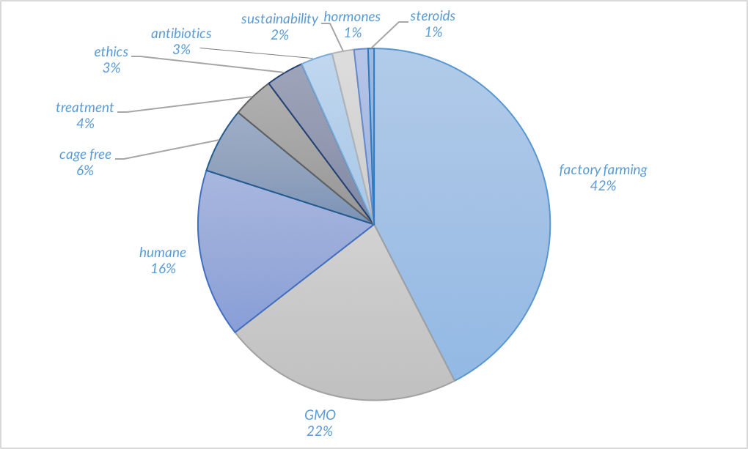
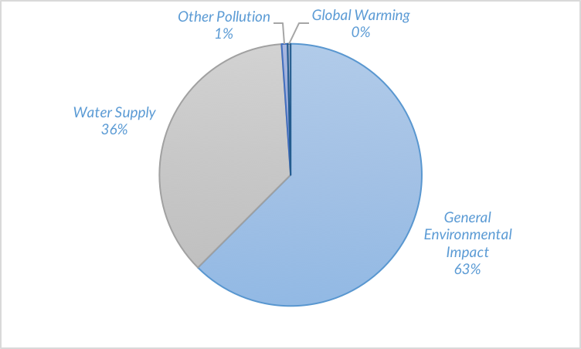
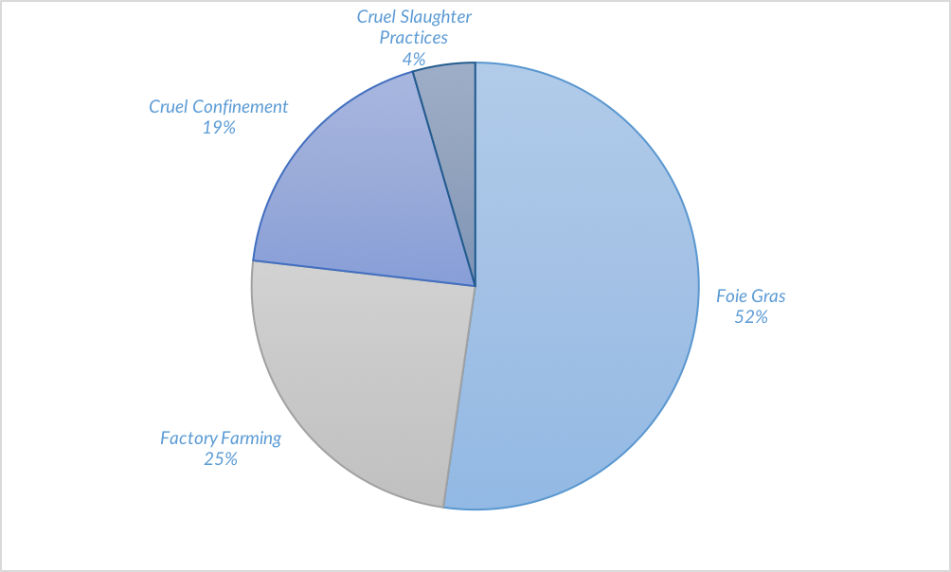
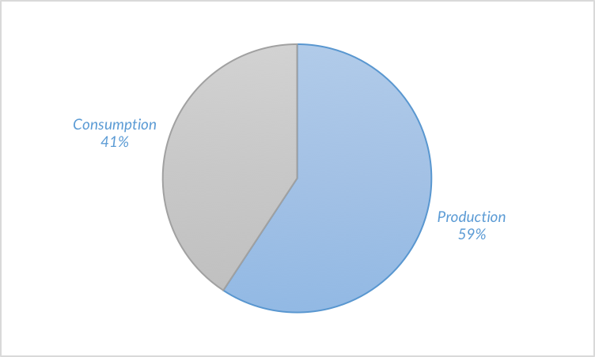
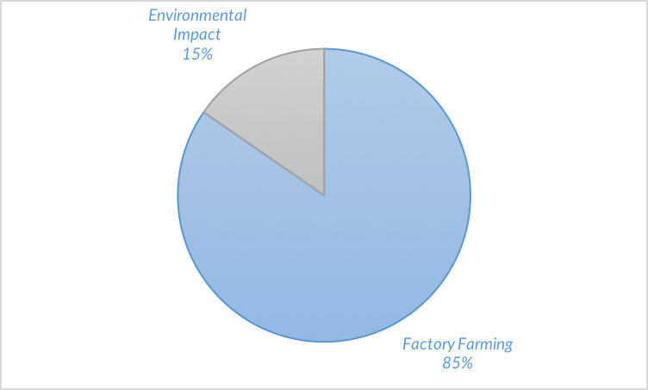
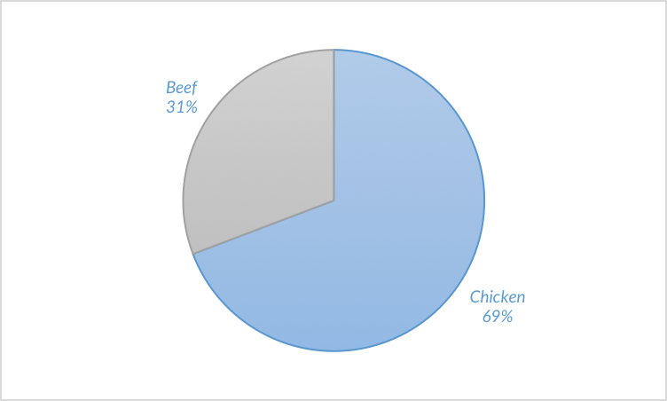
Sanderson Farms Insights for BBDO
Powered by Facebook Topic Data
Run Dates: 4/6/2016 – 4/25/2016
Animal Welfare Custom Conversation Insights
Keywords
Deep Dive: Environmental Impact
“Taste” is greatly associated with “great” and “love” at 45% and 14%, respectively. Those 35-44 (31%) over-indexed by 7% from the baseline when looking at just “taste” as a purchase motivator.
The 35-44 year old age group over-indexed by +4%. Millennials (18-24%) do not participate in the lunch conversation, but contribute at least 6% to the dinner convo.
Deep Dive: Factory Farming
Antibiotics: Production vs. Consumption
35-54 years old (50%) dominated the conversation around “Grill” whereas those 25-34 years old (29%) spoke to the “Fry” conversation
Influencers in Missouri over-indexed in conversation that associated chicken with a drink
Antibiotics Categories
Antibiotics Meat
“Delicious” is associated with Chicken at 55% and 25-34 year olds are driving the conversation 24%. 55% of females find chicken delicious
Conversation around “Walmart” is driven by Oregon and Washington at 79% and 21%, respectively, by 25-34 year olds (32%), and females (80%)

Slide 4
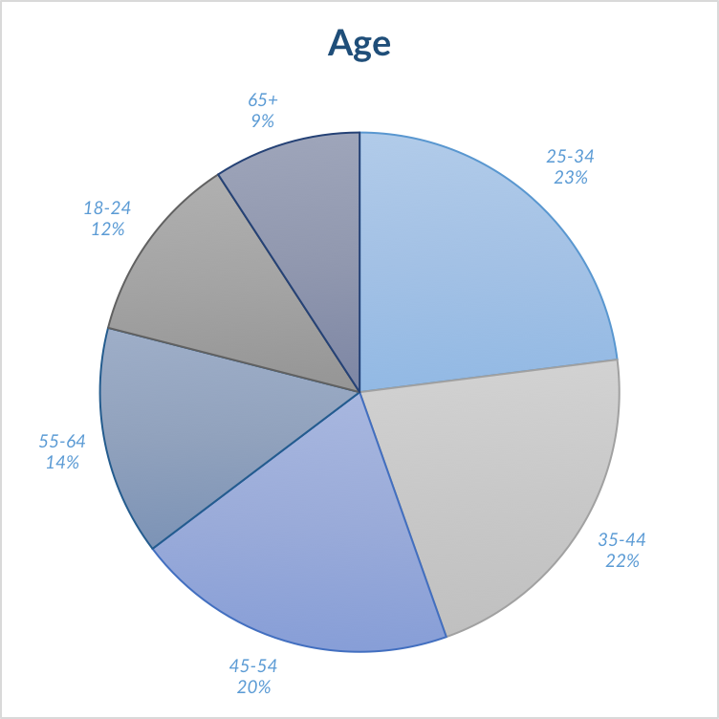
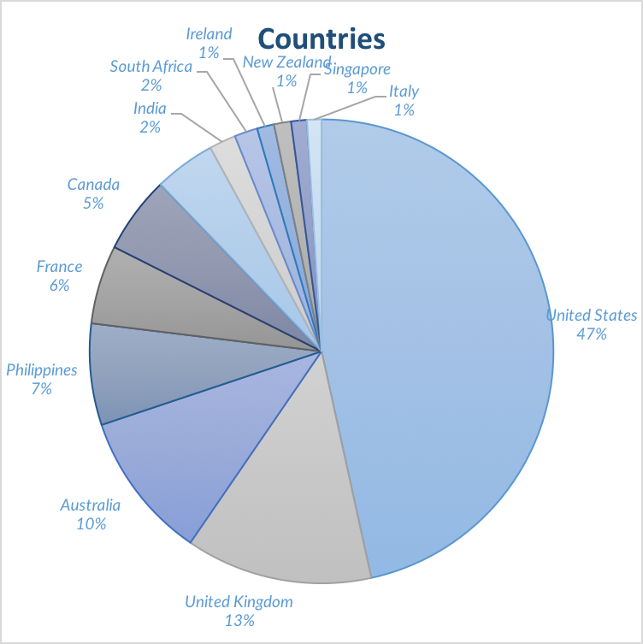
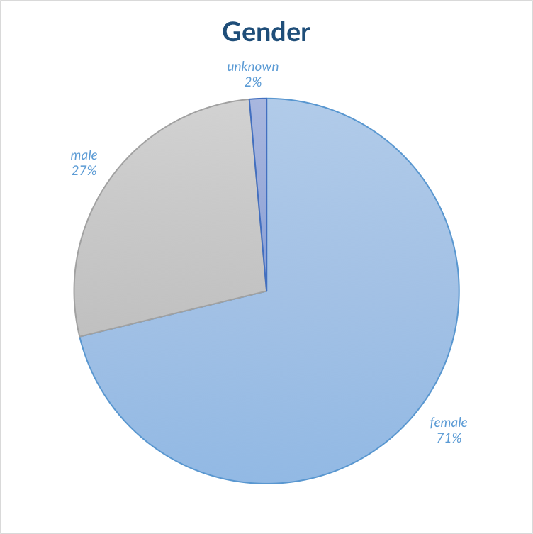
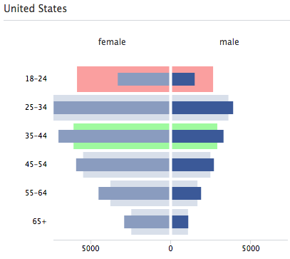
Sanderson Farms Insights for BBDO
Powered by Facebook Topic Data
Run Dates: 4/6/2016 – 4/25/2016
Animal Welfare Demographic Insights
Age Overview
18-24
11% of total interactions
6% Tyson Foods (Brands)
10% Positive (Sentiment)
25-34
24% of total interactions
6% Cost (Motivators)
4% Male (Gender)
35-44
24% of total interactions
13% Positive (Sentiment)
16% Posts (Media Type)
45-54
19% of total interactions
8% Dinner (Meals)
12% Taste (Motivator)
55-64
14% of total interactions
8% Positive (Sentiment)
17% Links (Media Type)
65+
8% of total interactions
5% Female
17% Positive Sentiment
Normalized Demo Data
Query
"Sanderson, Sanderson Farms, Perdue, JBS, Pilgrim's Pride, Pilgrims Pride, Tyson, Cargill, Sysco, Smithfield, Keystone, Con Agra”
AND
"chicken, chickens, product, products, bird, birds”
AND NOT
*Sanderson, Tyson, or Perdue used as a last name

Slide 5
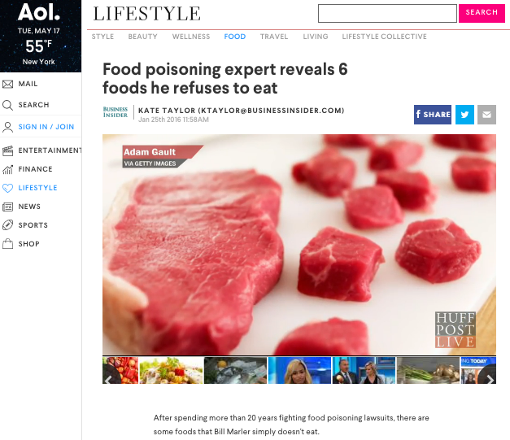
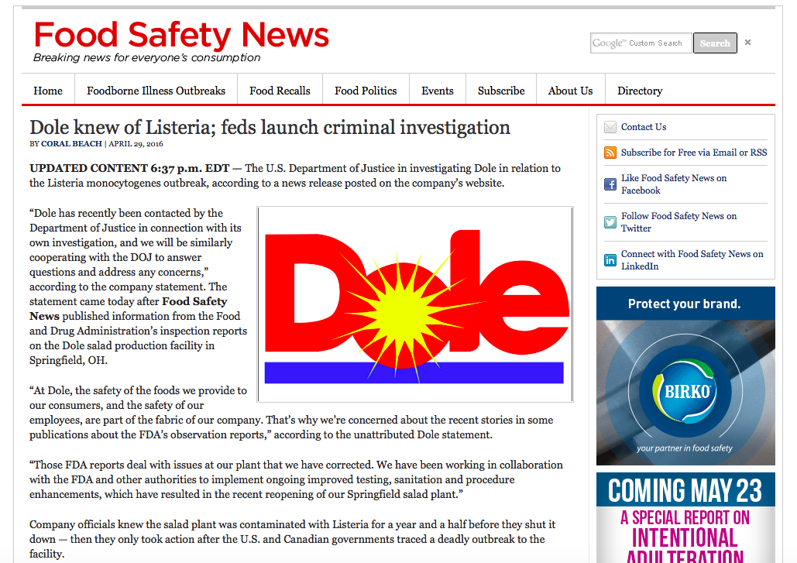
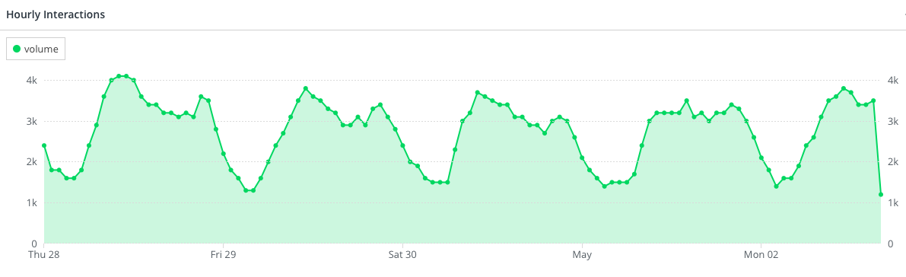
Sanderson Farms Insights for BBDO
Powered by Facebook Topic Data
Run Dates: 4/6/2016 – 4/25/2016
Food Safety Conversation Insights
Top 5 Links
None of the links were posted more than 100 times, but 75% of the interactions associated with the links were reshares, signaling that each article snowballed within Facebook as opposed to consumers reading the article elsewhere and feeling compelled to share it with friends on Facebook.
41% - Aol: Food Poisoning- 6 Foods
17% - Norovirus Outbreak on Cruise
15% - Food Safety News: Dole Knew of Listeria
14% - WSJ: U.S. Probes Dole
13% - French Listeria Outbreak
Brand Analysis
A large portion of the conversation surrounding Tyson came from influencers talking about “Tyson Chicken Nuggets”.
Tyson Foods also under-indexed on positive sentiment, decreasing 7% to 60% relative to the industry average of 67%.
Perdue Farms was largely associated with the word "free" because consumers interacted with and shared coupons on Facebook
Influencers were most motivated to buy Perdue Farms chicken because of it's color and affordable cost
Sanderson Farms made up 1% of the conversation
The majority of Sanderson’s share came from a specific link: http://www.sandersonfarms.com/store-finder/
Industry Conversation Insights
Daily Volume: On average there were more interactions per day on weekdays than weekends
Hourly Volume: The volume of data typically peaked between 8 and 10PM EST
Peak on April 14th : The largest peak in conversation was from April 14th – 15th due to an over-index of Tyson conversation with an over-index of engagements as opposed to actual posts.
342,600
Total Interactions

Slide 6
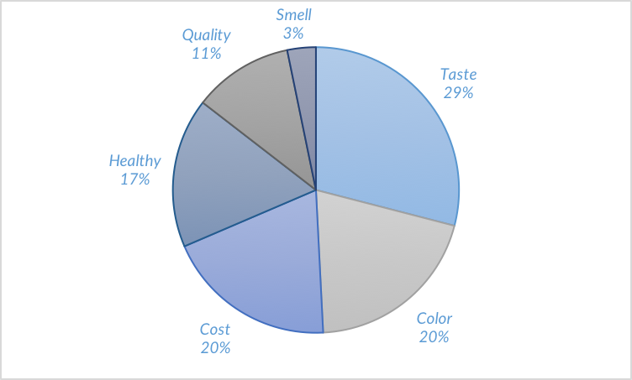
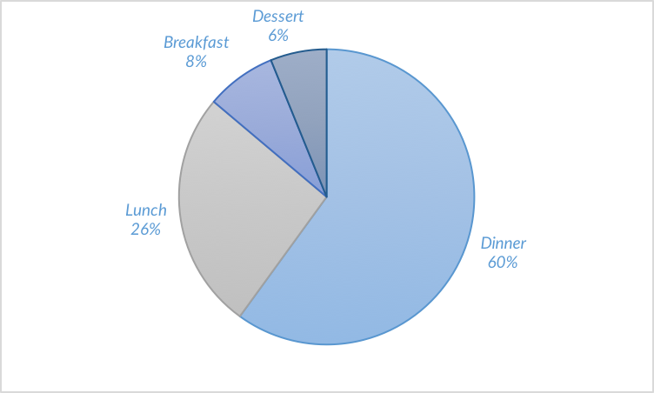
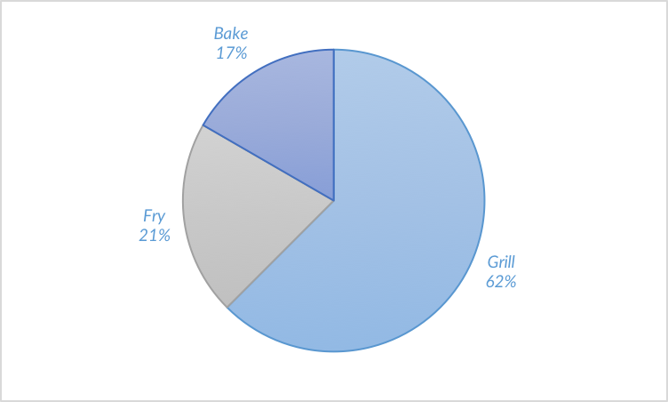
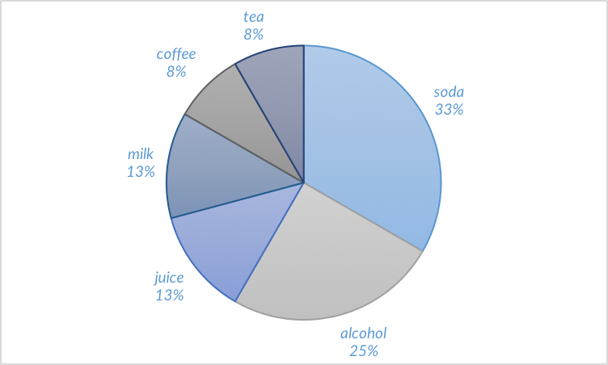
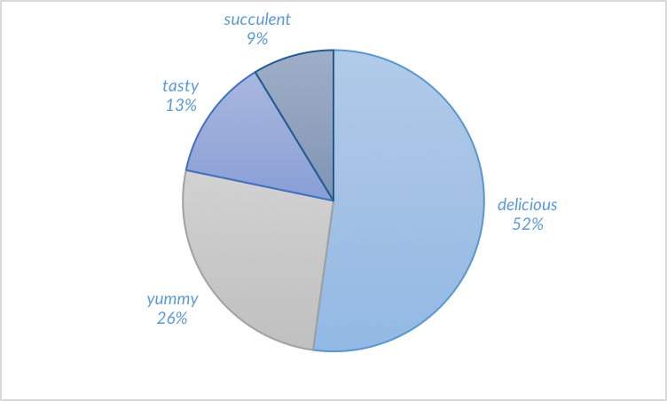
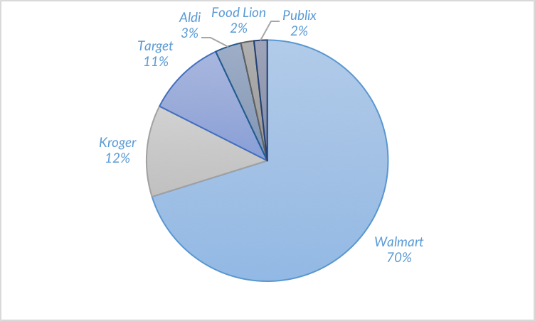
Sanderson Farms Insights for BBDO
Powered by Facebook Topic Data
Run Dates: 4/6/2016 – 4/25/2016
Food Safety Custom Conversation Insights
Purchase Motivators
Meals
“Taste” is greatly associated with “great” and “love” at 45% and 14%, respectively. Those 35-44 (31%) over-indexed by 7% from the baseline when looking at just “taste” as a purchase motivator.
The 35-44 year old age group over-indexed by +4%. Millennials (18-24%) do not participate in the lunch conversation, but contribute at least 6% to the dinner convo.
Preparation Methods
Drinks
35-54 years old (50%) dominated the conversation around “Grill” whereas those 25-34 years old (29%) spoke to the “Fry” conversation
Influencers in Missouri over-indexed in conversation that associated chicken with a drink
Taste
Stores
“Delicious” is associated with Chicken at 55% and 25-34 year olds are driving the conversation 24%. 55% of females find chicken delicious
Conversation around “Walmart” is driven by Oregon and Washington at 79% and 21%, respectively, by 25-34 year olds (32%), and females (80%)

Slide 7
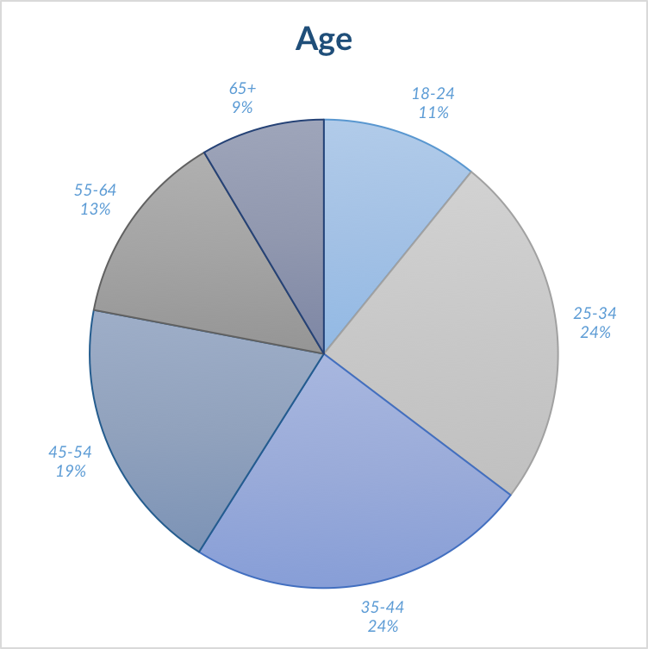
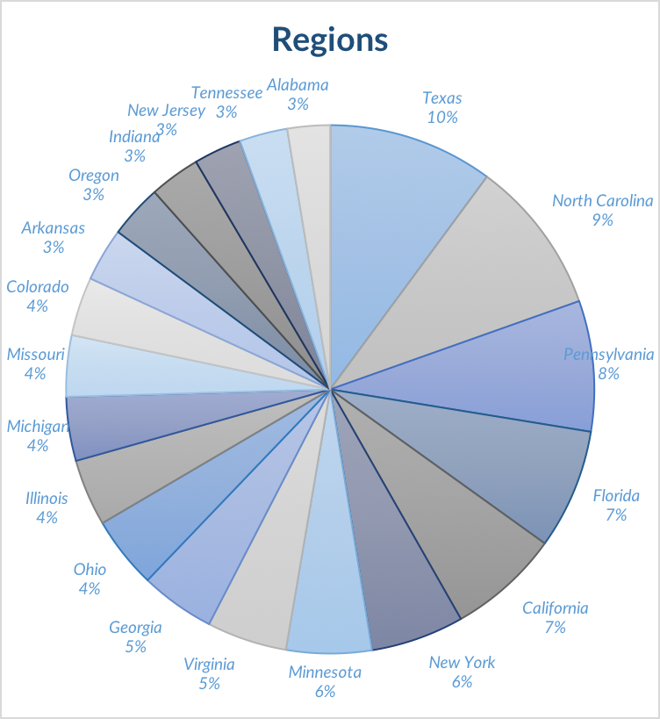
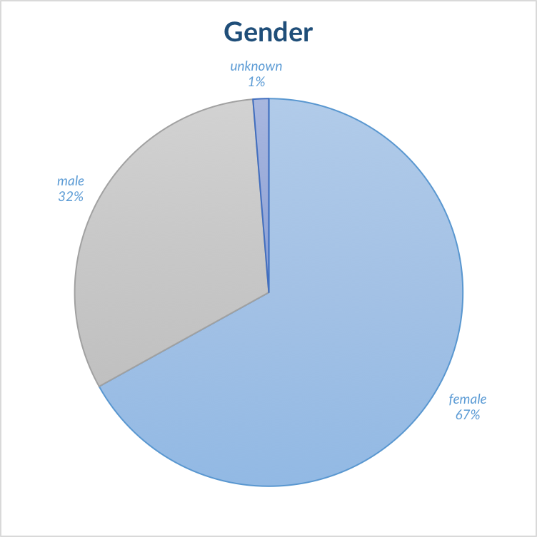
Sanderson Farms Insights for BBDO
Powered by Facebook Topic Data
Run Dates: 4/6/2016 – 4/25/2016
Food Safety Demographic Insights
Age Overview
18-24
11% of total interactions
6% Tyson Foods (Brands)
10% Positive (Sentiment)
25-34
24% of total interactions
6% Cost (Motivators)
4% Male (Gender)
35-44
24% of total interactions
13% Positive (Sentiment)
16% Posts (Media Type)
45-54
19% of total interactions
8% Dinner (Meals)
12% Taste (Motivator)
55-64
14% of total interactions
8% Positive (Sentiment)
17% Links (Media Type)
65+
8% of total interactions
5% Female
17% Positive Sentiment
Normalized Demo Data
Query
"Sanderson, Sanderson Farms, Perdue, JBS, Pilgrim's Pride, Pilgrims Pride, Tyson, Cargill, Sysco, Smithfield, Keystone, Con Agra”
AND
"chicken, chickens, product, products, bird, birds”
AND NOT
*Sanderson, Tyson, or Perdue used as a last name

